Slide 1
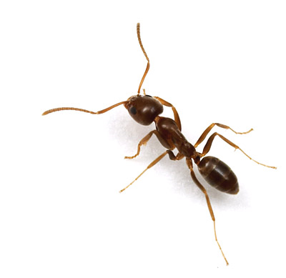
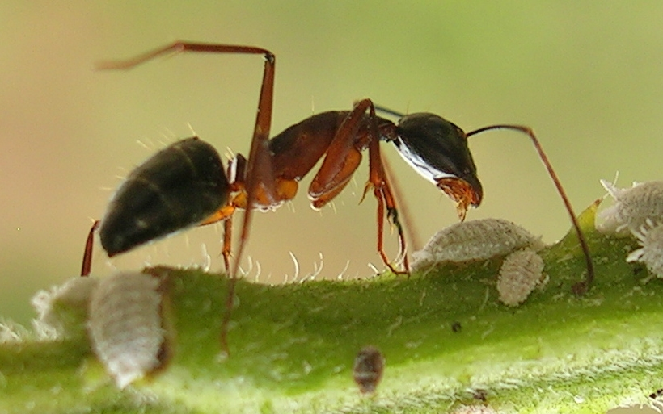
vastate.files.wordpress.com/2009/07/ant.jpg
upload.wikimedia.org/.../Ant_tending_scales3.jpg

Slide 2
Cite these if you use the photo!
upload.wikimedia.org/.../Ant_tending_scales3.jpg
upload.wikimedia.org/.../Ant_tending_scales3.jpg

Slide 3
Title

Slide 4
Deb Gor

Slide 5
History

Slide 6
Forager int.

Slide 7
More Forager

Slide 8
Nest Maintenance

Slide 9
Programs

Slide 10
Java

Slide 11
Star Logo

Slide 12
In Summary
Ants and other social insects use local information and interactions in order to run a colony as opposed to the more familiar hierarchical system of dissemination of information and commands
We are using the __ of simple basis behaviors to try and model the complex behavior of social insects

Slide 13
The Future
Understanding how to properly model this sort of behavior may allow for the modeling of other similar but more complex systems such as;
Neural networks
Immune Responses
Human interaction in city planning
Internet Interactions

